Slide 1


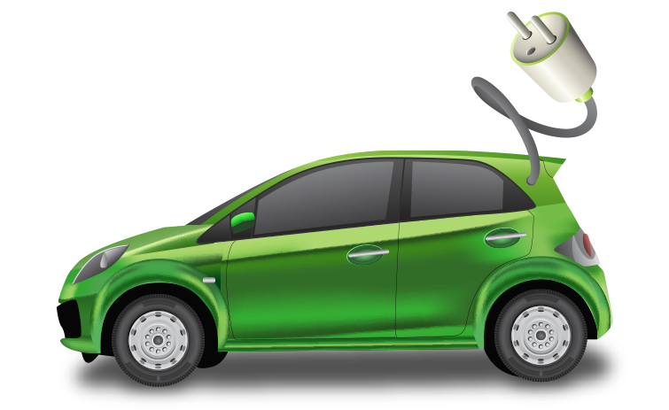
Ideathon 2024
Transparent Decision-Making for Electric Vehicle Routing:
Integrating DRL, GNN, and XAI
A Comparative Study of DRL Models with GNN and Explainable AI for Electric Vehicle Routing Optimization
Dimeth Nouicer; Elie N. Mulamba; Imen Habibi; Jérémie N. MABIALA; Mame Diarra Diouf; Souleymane Diallo
Notes:
Hello everyone. It’s a pleasure to be here at the Ideathon 2024.
So our research idea is Transparent Decision-Making for Electric Vehicle Routing.
Together with my colleagues—Ellie, Imen, Jérémie, Mame Diarra, and Souleymane
we want to conduct a comparative study of different models using RL, GNN and XAI techniques combined together to address these routing challenges.
—---------------------------------------
This project aims to tackle one of the most critical challenges in sustainable transportation: finding optimal and interpretable solutions for electric vehicle routing.
Which is not only technically challenging but also critically important in the context of sustainable transport and climate change:

Slide 2
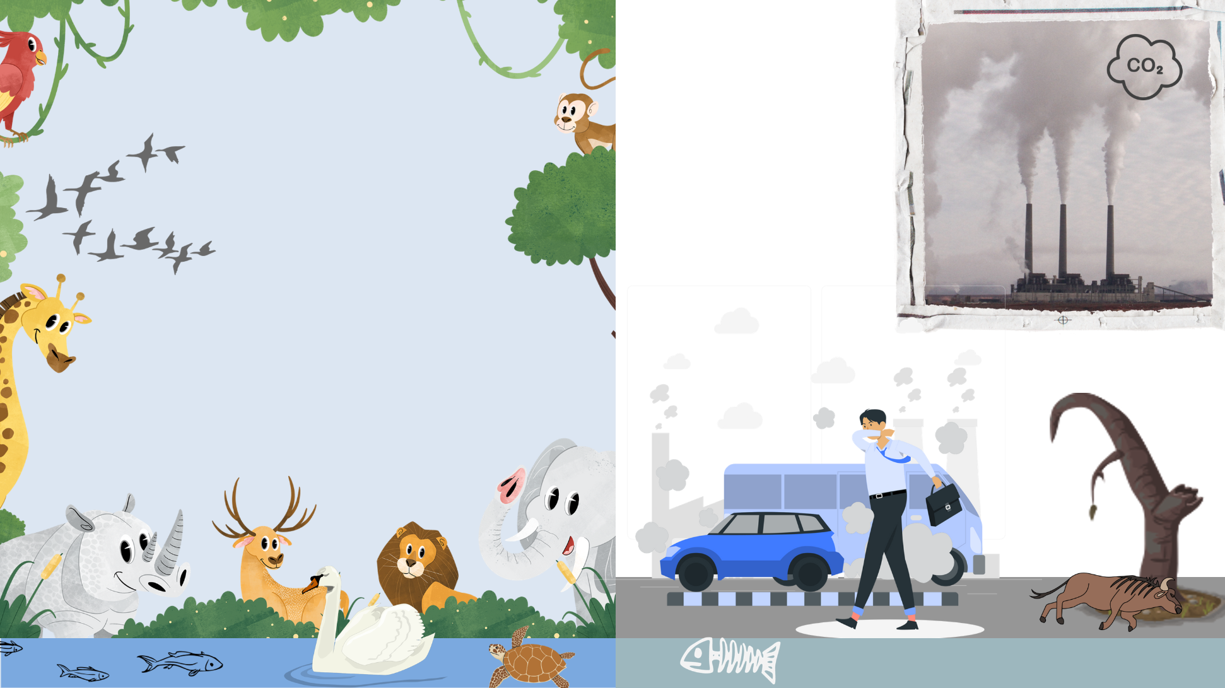

Climate Change
Notes:
So Climate change is one of the most pressing issues of our time.
Global temperatures are rising at a fast rate, causing damages everywhere.
One of the main reasons is the green house gas emissions caused by industries and transportation

Slide 3

The Role of Transportation in Climate Change
Notes:
For instance The transportation sector is the second sector that accounts for a significant portion of global CO2 emissions.
One of the envisaged solutions is the transition to Electric Vehicles
Which represent a key solution for reducing dependency on fossil fuels and greenhouse gas emissions.
This is not just an option, it’s a necessity.

Slide 4
The Role of Transportation in Climate Change
Anxiety of
Limited battery range
Long charging duration
Notes:
For instance The transportation sector accounts for a significant portion of global CO2 emissions.
One of the envisaged solutions is the transition to Electric Vehicles
Which represent a key solution for reducing dependency on fossil fuels and greenhouse gas emissions.
This is not just an option, it’s a necessity.
However, there is this anxiety with EVs due to their limited battery range and long charging duration

Slide 5
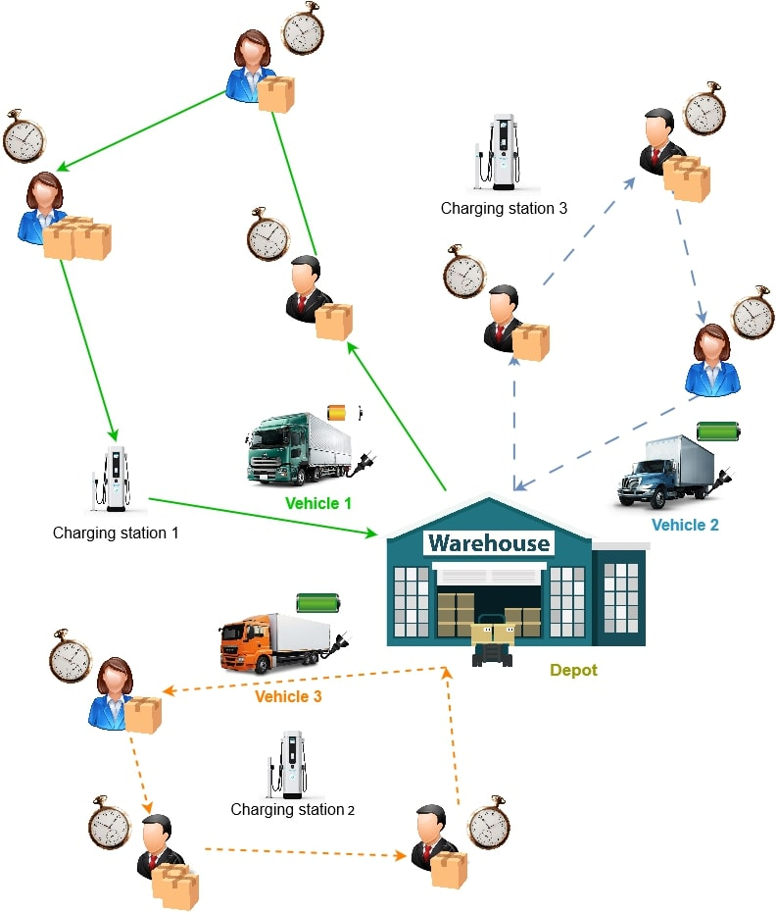
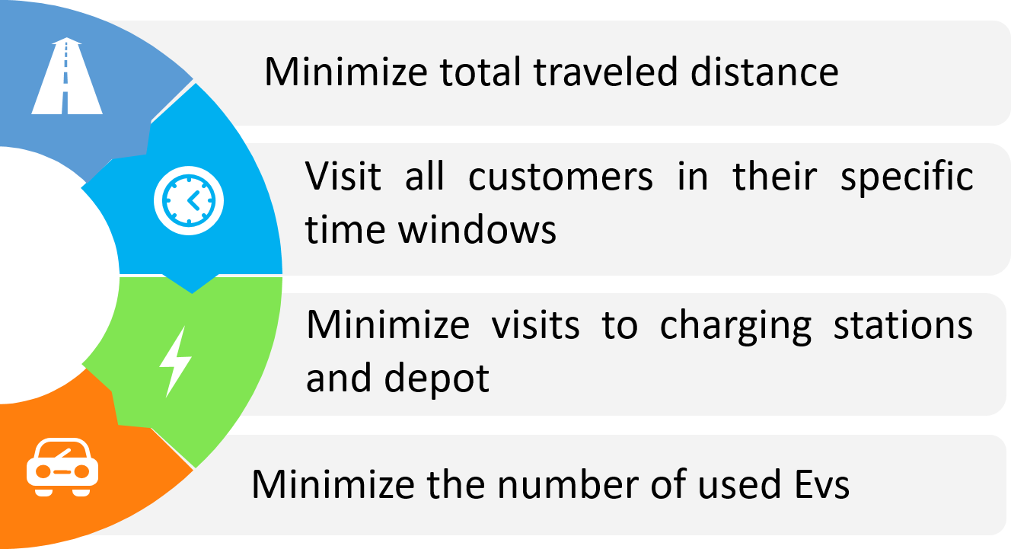
Introduction to Electric Vehicle Routing Problem (EVRP)
Combinatorial Optimization (CO) NP-hard problem that aims to determine the most efficient routes for a fleet of electric vehicles (EVs)
A Variant of VRP
Generalization of Traveler Salesman Problem (TSP)
Notes:
This is where the Electric Vehicle Routing Problem, comes into play.
It’s an Optimization problem that aims to determine the most efficient routes for a fleet of electric vehicles (EVs)
It’s a variant of vehicle routing problem which is a generalization of the TSP problem.
Similarly to VRP we want to visit all destinations, or customers location in the case of commercial fleets, within a minimum total distance
in a specific time window for each customer
Additionally, EVRP considers constraints related to EVs like battery limits and charging station availability.
and if possible to minimize the number of vehicles dispatched
All the references we used are listed at the end of the presentation
—---------------------------------
This growing demand for explainability has sparked interest from researchers in various fields, including transportation field and the common problem of Vehicle Routing.

Slide 6
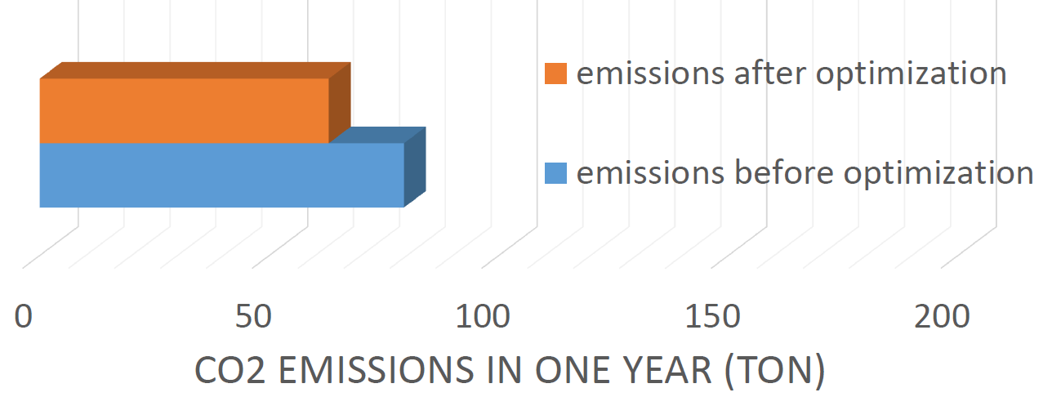
Introduction to Electric Vehicle Routing Problem (EVRP)
Notes:
A study was conducted on the ENV impact of EVRP in Tunisia and it’s clearly able to reduce co2 emissions.
So It’s a complex yet crucial problem that directly impacts sustainable transportation.

Slide 7
Existing Solving Methods for EVRP
EVRP
Exact Methods
Heuristic Methods
Dynamic Programming
Branch and Bound
Genetic Algorithms
Tabu Search Algorithm
Notes:
So how do we solve this problem?
Traditional routing algorithms, have been effective for simpler routing cases, However, they fail as the problem size grows
There was this study by Lin et al. that showed how heuristics for example fail to find any solution for instances with more than 30 customers.

Slide 8

Reinforcement Learning (RL) and Decision-making
Decision 1
Final solution
Decision n
R
Sequence of decisions
P
…
D
A
Decision 2
Solve complex sequential decision-making problems
Notes:
And This is where reinforcement learning shines.
RL is a type of machine learning in which an agent learns to make decisions by interacting with an environment.and receiving rewards or penalties based on its actions.
It is inspired by behavioral psychology, where agents learn to achieve goals by maximizing rewards through a process of trial and error.
RL, has emerged as a powerful approach to solving complex, sequential decision-making problems.
each decision an RL agent makes affects the next decision and so on.

Slide 9
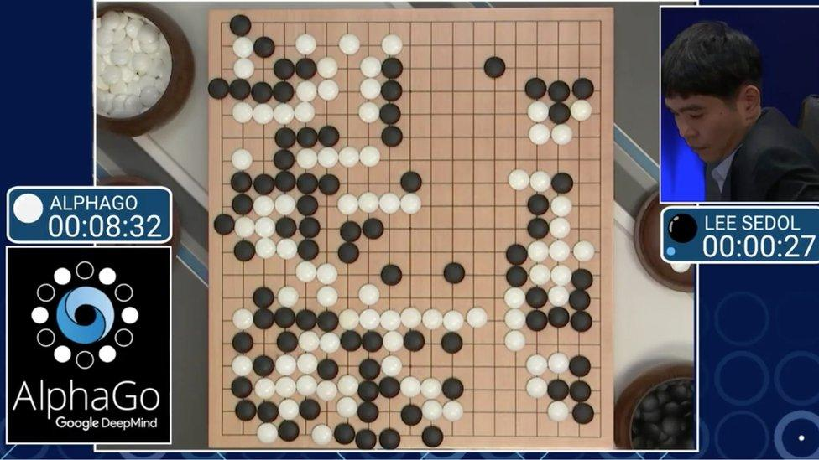
Reinforcement learning
Decision 37
Decision 1
Turned the course of the game in AlphaGo’s favour
Final solution
AlphaGo’s Victory
…
Decision 2
AlphaGo’s second challenge against Lee Sedol (ranked 9-dan)
Notes:
A famous example that illustrates the potential of RL is AlphaGo,
the AI that famously defeated the world champion Go player, Lee Sedol.
AlphaGo excelled at this because Go, like many real-world problems,
is about making decisions over time, considering not just the immediate consequence but also the long-term impact.
However, during AlphaGo’s second challenge against Lee Sedol, AlphaGo made its now-legendary 37th move
—a decision that surprised both commentators & Lee Sedol
It was a creative, unpredictable move that shifted the game in AlphaGo's favor.

Slide 10
Reinforcement learning
Decision 37
Decision 1
Surprised both commentators & Lee Sedol
Final solution
AlphaGo’s Victory
…
Decision 2
David Silver, DeepMind researcher, reportedly had no insight into why AlphaGo made such a creative move until he had investigated the actual calculations made by the programme
Notes:
However, the logic behind this move wasn’t clear, even to its developers.
Even David Silver, one of DeepMind's lead researchers,
admitted that he didn’t fully understand why the program made such a choice until after he investigated the program’s inner calculations.
Next slide:

Slide 11
Reinforcement learning
Decision 37
Decision 1
surprised both commentators & Lee Sedol
Final solution
Victory
…
Decision 2
David Silver, DeepMind researcher, reportedly had no insight into why AlphaGo made such a creative move until he had investigated the actual calculations made by the programme [2]
Operate as a black-box
Lack of interpretability
Notes:
This brings us to a critical issue: as effective as RL models can be,
they often function like 'black boxes,'
making decisions that are not easily interpretable to human users
Now, imagine this kind of AI being used by non-experts in everyday applications without an ability to explain its reasoning.
This lack of interpretability is a major concern, particularly in safety-critical applications like EV routing.

Slide 12
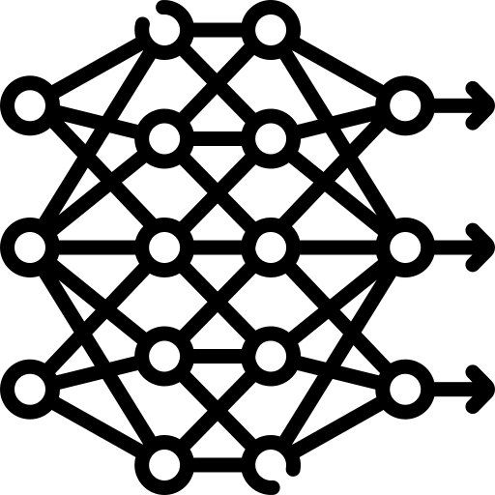
The Need for Explainable AI (XAI)
Model Input
Model Output
What problem?
Explanation meaning?
How?
Why?
What consequences?
Notes:
Explainable AI is a key to addressing this challenge. XAI helps break down AI decisions into understandable explanations,
making it easier for operators, drivers, and fleet managers to trust the AI’s recommendations
Even for AI developers when optimizing the model output
We no longer need to wonder if it is a problem with the fine tuning, or maybe the architecture, or is it in the definition of the state and reward ?
But even if we add a layer of explainability to interpret the model’s decisions, would that be enough?
Is the provided explanation (which is based on AI as well)is it understandable? how good is it to non experts especially
As these systems move closer to real-world use, AI needs to be able to explain Its decisions in a way people can understand.

Slide 13
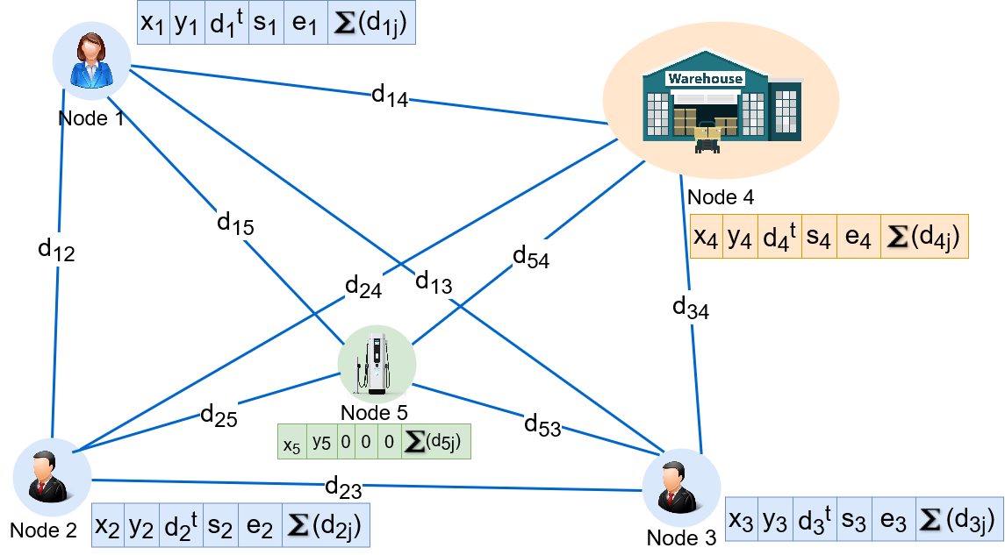
Explainable RL in EVRP
Real world application
Climate change and sustainable transport
NP hard Combinatorial Optimization
Complex sequential decision making
Graph Neural Networks
Enhance RL models: DRL and GNN have shown promise in optimizing complex routing problems
Transparency
Opaque decision-making can be costly or unsafe.
Notes:
So this is where our research comes in.
We want to combine the strengths of Deep Reinforcement Learning with Graph Neural Networks and Explainable AI.
While RL handles the decision-making, and GNNs offer a way to process graph-structured data,
which is particularly useful in routing scenarios as they can be modeled as a graph.
And XAI, ensures transparency by providing clear explanations for the model’s decisions.

Slide 14

Gap in research
Comparative analysis to evaluate how different DRL models perform when combined with GNN
Human-interpretable insights from XAI for EVRP
Combination of DRL, GNN, and XAI
Application of DRL GNN XAI in real world EVRP application
(we own a real world dataset )
Notes:
For this we checked the gap in research and this is what we found:
there is a lack of the integration of XAI for EVRP.
Second, a comparative analysis to evaluate how different DRL models perform to help identify the strengths and weaknesses of each model
has also not been thoroughly explored for the context of EV routing.
Third,the combination of DRL, GNN, and XAI
has not been thoroughly explored, especially in the context of vehicle routing.
And Finally,
many studies remain theoretical so there is a gap in the real-world application

Slide 15
How are we going to tackle these gaps?
Notes:
So if we want to tackle the gap in research how do we do that?

Slide 16
Research Idea
Our research aims to conduct a comparative study of various DRL models integrated with GNN and XAI.
We will evaluate their performance in optimizing routes and how well each model explains its decisions.
Notes:
Our research aims to conduct a comparative study of various DRL models integrated with GNN and XAI.
We will evaluate their performance in optimizing routes and how well each model explains its decisions.

Slide 17
Methodology Overview
Explainable AI (XAI)
03
Deep Reinforcement Learning (DRL)
01
02
Graph Neural Networks (GNN)
Notes:
, our methodology To achieve this is
Initial model development to tackle EVRP using DRL and GNN.
Then
Integration of XAI techniques for interpretability.

Slide 18
Methodology Overview
Explainable AI (XAI)
03
Deep Reinforcement Learning (DRL)
Different DRL models have different strengths and weaknesses
02
01
Graph Neural Networks (GNN)
Evaluate both performance:
How well each model solves EVRP
Interpretability: how well XAI “explains” the model's decisions
Notes:
Different DRL models have different strengths and weaknesses
So We want to
Evaluate both performance:
How well each model solves EVRP
And how well XAI “explains” the model's decisions

Slide 19
Research idea
AI for Sustainability
Evaluate both the optimization performance of each model and their interpretability
Comparative analysis
Comparative analysis of various DRL models combined with GNN and XAI
Scalable & Explainable
Interpretable and optimized solution for EVRP leveraging DRL, GNN, and XAI techniques
Notes:
Our key contributions to this research include:
Interpretable and optimized models for EVRP leveraging DRL, GNN, and XAI techniques
Comparative analysis of these various models
And we evaluate both the optimization performance of each model and their interpretability

Slide 20
Impact of this research?
Feasibility and ethical concerns?

Slide 21
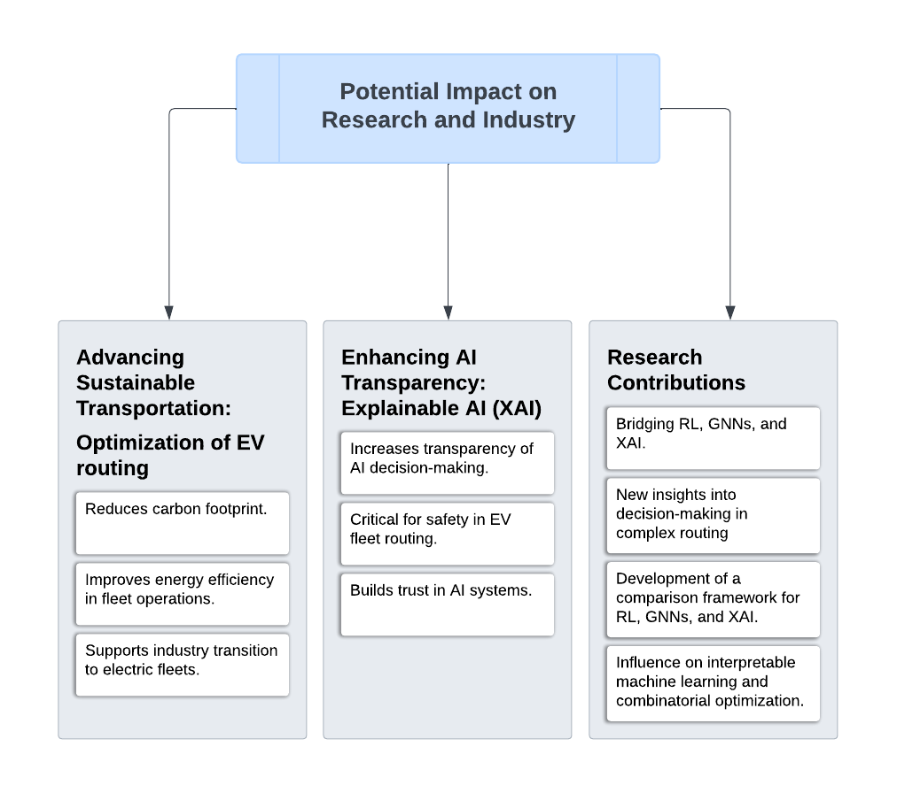
[4]
Notes:
"Now, let’s explore the potential impact of this research on both the academic and industrial landscapes. The first key area is advancing sustainable transportation. By optimizing electric vehicle routing, we are directly contributing to a reduction in carbon footprints within transportation networks, making fleet operations more energy-efficient and supporting industries transitioning to electric fleets. Additionally, enhancing AI transparency through Explainable AI addresses the challenges posed by the 'black box' nature of AI models. In critical applications like EV fleet routing, this transparency will improve trust and prevent errors by making the AI decision-making process understandable. Finally, this research will bridge the gap between Reinforcement Learning, Graph Neural Networks, and Explainable AI, offering new insights and creating a framework that could influence future work in both interpretable machine learning and combinatorial optimization."

Slide 22
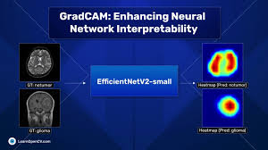
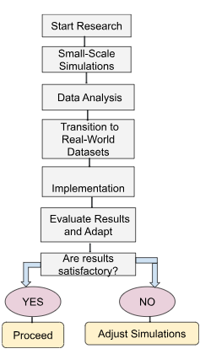






Feasibility of the Research Idea
Established Tools and Resources
Support from Literature
Scalability
Mature AI Libraries
XAI Techniques
Growing Body of Research
Gradual Scaling Approach
Support development of RL and GNN models
Well-documented for interpretability"
Guides direction for interpretable AI and EV routing
Ensures testable and adaptable methodology
Notes:
"Now that we’ve seen the impact, let's discuss why this research idea is feasible. We are supported by established tools and resources, with mature AI libraries like PyTorch and TensorFlow, and explainability techniques such as SHAP, and Grad-CAM which ensure that our interpretability goals are within reach. Additionally, existing literature provides a solid foundation, guiding our direction with previous work on XAI, RL, and GNNs. Scalability is another advantage—starting with small simulations, we can gradually scale to real-world datasets, ensuring that the approach is both adaptable and testable.

Slide 23



Ethical Considerations in EVRP Research
Data Privacy [5]
Transparency and Accountability [6]
Environmental Impact [7]
Anonymization
Privacy Protection
Explainable AI
Stakeholder Clarity
Sustainable Transportation
Carbon Emission Reduction
Ensure all data is anonymized.
Follow strict privacy protocols in line with industry standards.
Promotes accountability in safety-critical areas.
Promote eco-friendly routing.
Aligns with global sustainability goals.
Reduces risk of opaque decisions.
Notes:
"Now, moving on to the ethical considerations, which are central to any impactful research. First, data privacy is a significant concern, especially when dealing with real-world datasets for electric vehicle routing. To mitigate this, we will ensure that all data is anonymized and follow strict privacy protection protocols. Moreover, by integrating Explainable AI, we not only gain technical transparency but also promote ethical transparency—making sure that decisions are clear, understandable, and accountable, particularly in safety-critical scenarios like vehicle routing. Additionally, the environmental impact of this research is significant. By promoting sustainable transportation and reducing carbon emissions through optimized routing for electric vehicles, we aim to contribute positively to global sustainability goals and lessen the environmental footprint.
:Mantelero, A. (2013). "The EU Proposal for a General Data Protection Regulation and the roots of the 'right to be forgotten'." Computer Law & Security Review, 29(3), 229-235.
6: https://link.springer.com/book/10.1007/978-3-030-30371-6
7 https://www.sciencedirect.com/science/article/pii/S1364032123010341

Slide 24
Who is the team?
Notes:
So now Let me introduce our team who will be working on this research paper

Slide 25



Team
 |  | Background | Team Role
Dimeth NOUICER | Tunisia | PhD in Electric-Mobility and RL | Team Lead and Coordinator
Ellie MULAMBA | Democratic Republic of the Congo | PhD in ML and NLP | Evaluation Lead: Define appropriate metrics and track performance
Jérémie N. MABIALA | Democratic Republic of the Congo | Masters in AI Masters in Maths | Technical Lead: Ensures any technical challenges are addressed
Imen HABIBI | Tunisia | Undergraduate engineering student in AI | Model development
Mame Diarra DIOUF | Senegal | Masters student in AI and operational research | Model development
Souleymane DIALLO | Senegal | Undergraduate engineering student in AI | Model development
Notes:
We are a team of 6 members composed of various backgrounds: As the Team Lead, I, Dimeth, recently completed my PhD in E-Mobility and RL,
Which gave me experience with both EVRP and RL
Elie, our Evaluation Lead, is currently pursuing his PhD in ML and NLP.
Jérémie holds two master's degrees in AI and Mathematics.
So With his strong technical background, he will serve as the Technical Lead
We also have Imen, Mame, and Souleymane, who are either master's and undergraduate students specializing in AI.
They will be the driving force behind the development and training of our models, working hands-on to bring our solutions to life

Slide 26
 | Background | Model | Article
Dimeth Nouicer | PhD in E-Mobility and RL | Literature Review and Background Research: key findings, frameworks, and techniques | Writing: Introduction and background Literature review Conclusion and Future Work
Elie Mulamba | PhD in ML and NLP | XAI Integration and Analysis Performance Evaluation and Comparison Study | Writing: XAI and Analysis Results and discussion Paper Review
Jérémie N. MABIALA | Masters in AI Masters in Maths | Methodology and conception: Problem Definition Model selection Architectures to evaluate | Writing: Methods and models Implementation
Imen Habibi | Undergraduate engineering student in AI | RL-GNN Model 1 Implementation and Training
Mame Diarra Diouf | Masters student in AI and operational research | RL-GNN Model 2 Implementation and Training
Souleymane DIALLO | Undergraduate engineering student in AI | RL-GNN Model 3 Implementation and Training
Notes:
Now this is how each member will contribute to the project in terms of model development, research, and article writing.
As the Team Lead, I will focus on literature review and background research
I will also handle the writing of the introduction, background, and conclusion sections of our final article.
Elie, will manage the integration of XAI and conduct performance evaluation and comparison studies of the models.
He will also write the sections covering XAI, analysis, and discussion, as well as oversee the paper review process.
Jérémie will handle methodology and model design, focusing on problem definition, model selection, and evaluating different architectures.
He will also write the methods and model implementation sections of the article.
Meanwhile, Imen, Mame, and Souleymane will be deeply involved in model development.
Each one will focus on implementing and training a combined RL/GNN model

Slide 27
What is the plan to this paper?
Notes:
So how are we going to make this work?

Slide 28
Plan of the idea
Phase | Objective | Tasks | Timeline
1. Project Initialization and Research | Establish a solid understanding of DRL, GNN, and XAI. | - Conduct literature review. - Analyze existing datasets. - Finalize project scope and define problems. | Weeks 1-2
2. Data Preparation | Create a robust dataset for model training, testing, and evaluation. | - Gather real-world data or use publicly available datasets. - Preprocess data. - Generate synthetic data if needed. | Week 3
3. Model Development | Develop DRL and GNN models for EVRP. | - Implement multiple DRL algorithms and GNN architectures. - Integrate models. - Train models for performance optimization. | Weeks 4-7
4. Explainability Integration | Enhance models with XAI features for interpretability. | - Integrate XAI techniques. - Develop methods to explain model decisions. - Test and adjust explainability features. | Weeks 8-9

Slide 29
Plan of the idea(continue)
5. Performance Evaluation and Comparison | Evaluate model performance and explainability. | - Define performance metrics. - Conduct experiments for comparison. - Compile and analyze results. | Weeks 10-11
6. Optimization and Scalability Testing | Ensure models are scalable and efficient. | - Optimize for computational efficiency. - Test scalability across various scenarios. - Adjust models for adaptability. | Week 12
7. Documentation and Report Writing | Prepare comprehensive documentation and reports. | - Document methodology and model implementations. - Write a detailed report on findings. - Prepare code repositories and manuals. | Weeks 13-14
8. Final Presentation and Review | Present research findings and gather feedback. | - Prepare final presentation. - Demonstrate models and features. - Collect feedback for further improvements. | Week 15

Slide 30
References
[1] Metz C (2017) ‘‘In two moves, AlphaGo and Lee Sedol redefined the future,’’. accessed: 2024-10-15
[2] Metz C (2017) ‘‘How google’s AI viewed the move no human could understand,’’ . 2024-10-15
[3] Cruz F, Young C, Dazeley R, Vamplew P (2022) ‘‘Evaluating human-like explanations for robot actions in reinforcement learning scenarios,’’ In: 2022 IEEE/RSJ International Conference on Intelligent Robots and Systems (IROS), pp. 894–901,IEEE
[4] Dazeley, R., Vamplew, P. & Cruz, F. Explainable reinforcement learning for broad-XAI: a conceptual framework and survey. Neural Comput & Applic 35, 16893–16916 (2023). https://doi.org/10.1007/s00521-023-08423-1
[5] Nouicer, D., Msadaa, I. C., & Grayaa, K. (2023). *A Novel Routing Solution for EV Fleets: A Real-World Case Study Leveraging Double DQNs and Graph-Structured Data to Solve the EVRPTW Problem*. IEEE Access, PP(99):1-1. https://doi.org/10.1109/ACCESS.2023.3327324.
[6] B. Lin, B. Ghaddar and J. Nathwani, "Deep Reinforcement Learning for the Electric Vehicle Routing Problem With Time Windows," in IEEE Transactions on Intelligent Transportation Systems, vol. 23, no. 8, pp. 11528-11538, Aug. 2022, doi: 10.1109/TITS.2021.3105232.
[7] Kool, W., van Hoof, H., & Welling, M. (2019). Attention, Learn to Solve Routing Problems! In International Conference on Learning Representations.
[8] Stephanie Milani, Nicholay Topin, Manuela Veloso, and Fei Fang. 2024. Explainable Reinforcement Learning: A Survey and Comparative Review. ACM Comput. Surv. 56, 7, Article 168 (July 2024), 36 pages. https://doi.org/10.1145/3616864
[9] M. Wang, Y. Wei, X. Huang and S. Gao, "An End-to-End Deep Reinforcement Learning Framework for Electric Vehicle Routing Problem," in IEEE Internet of Things Journal, doi: 10.1109/JIOT.2024.3432911.
[10] Glanois, C., Weng, P., Zimmer, M. et al. A survey on interpretable reinforcement learning. Mach Learn 113, 5847–5890 (2024). https://doi.org/10.1007/s10994-024-06543-w
Notes:
Of course, this presentation is built upon a foundation of existing research.
And These are the references we used

Slide 31
The road to innovation is not just about reaching a destination;
it’s about making the journey smarter, greener, and more understandable for everyone
Let’s drive change forward, one decision at a time
Notes:
To conclude, I want to emphasize that
Together, we have the power to not just solve problems but redefine the future of sustainable transport.
the road to innovation is not just about reaching a destination; it’s about making the journey smarter, greener, and more understandable for everyone.
So, let’s drive change forward, one decision at a time.
Thank you for your attention.

